Slide 2
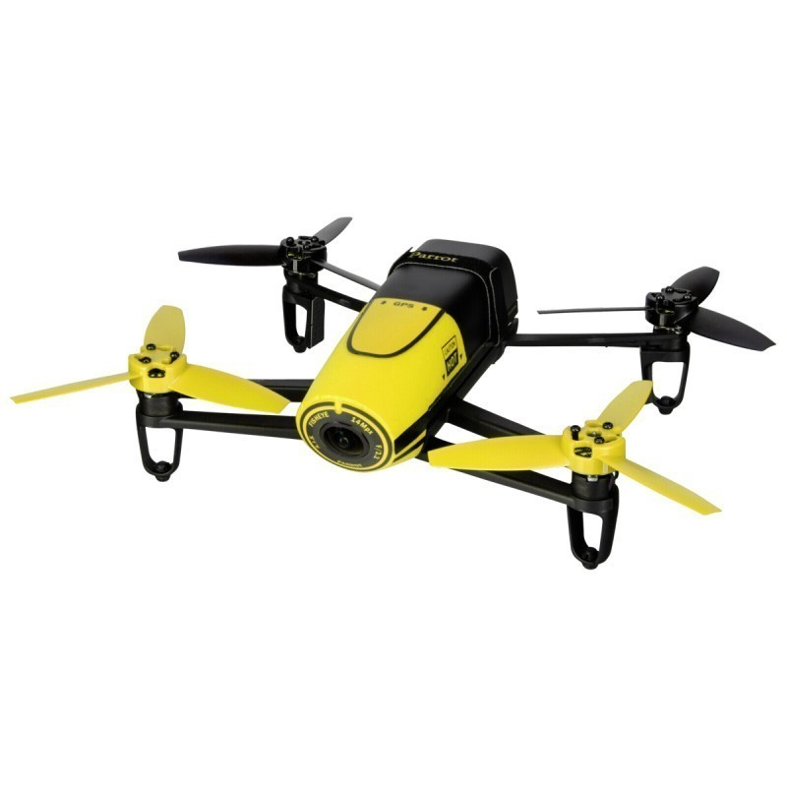
Bebop drone
#adroidstudio #android #java #androidvision #videostream #relativemove #tilt #roll #yaw #gaz

